Slide 1
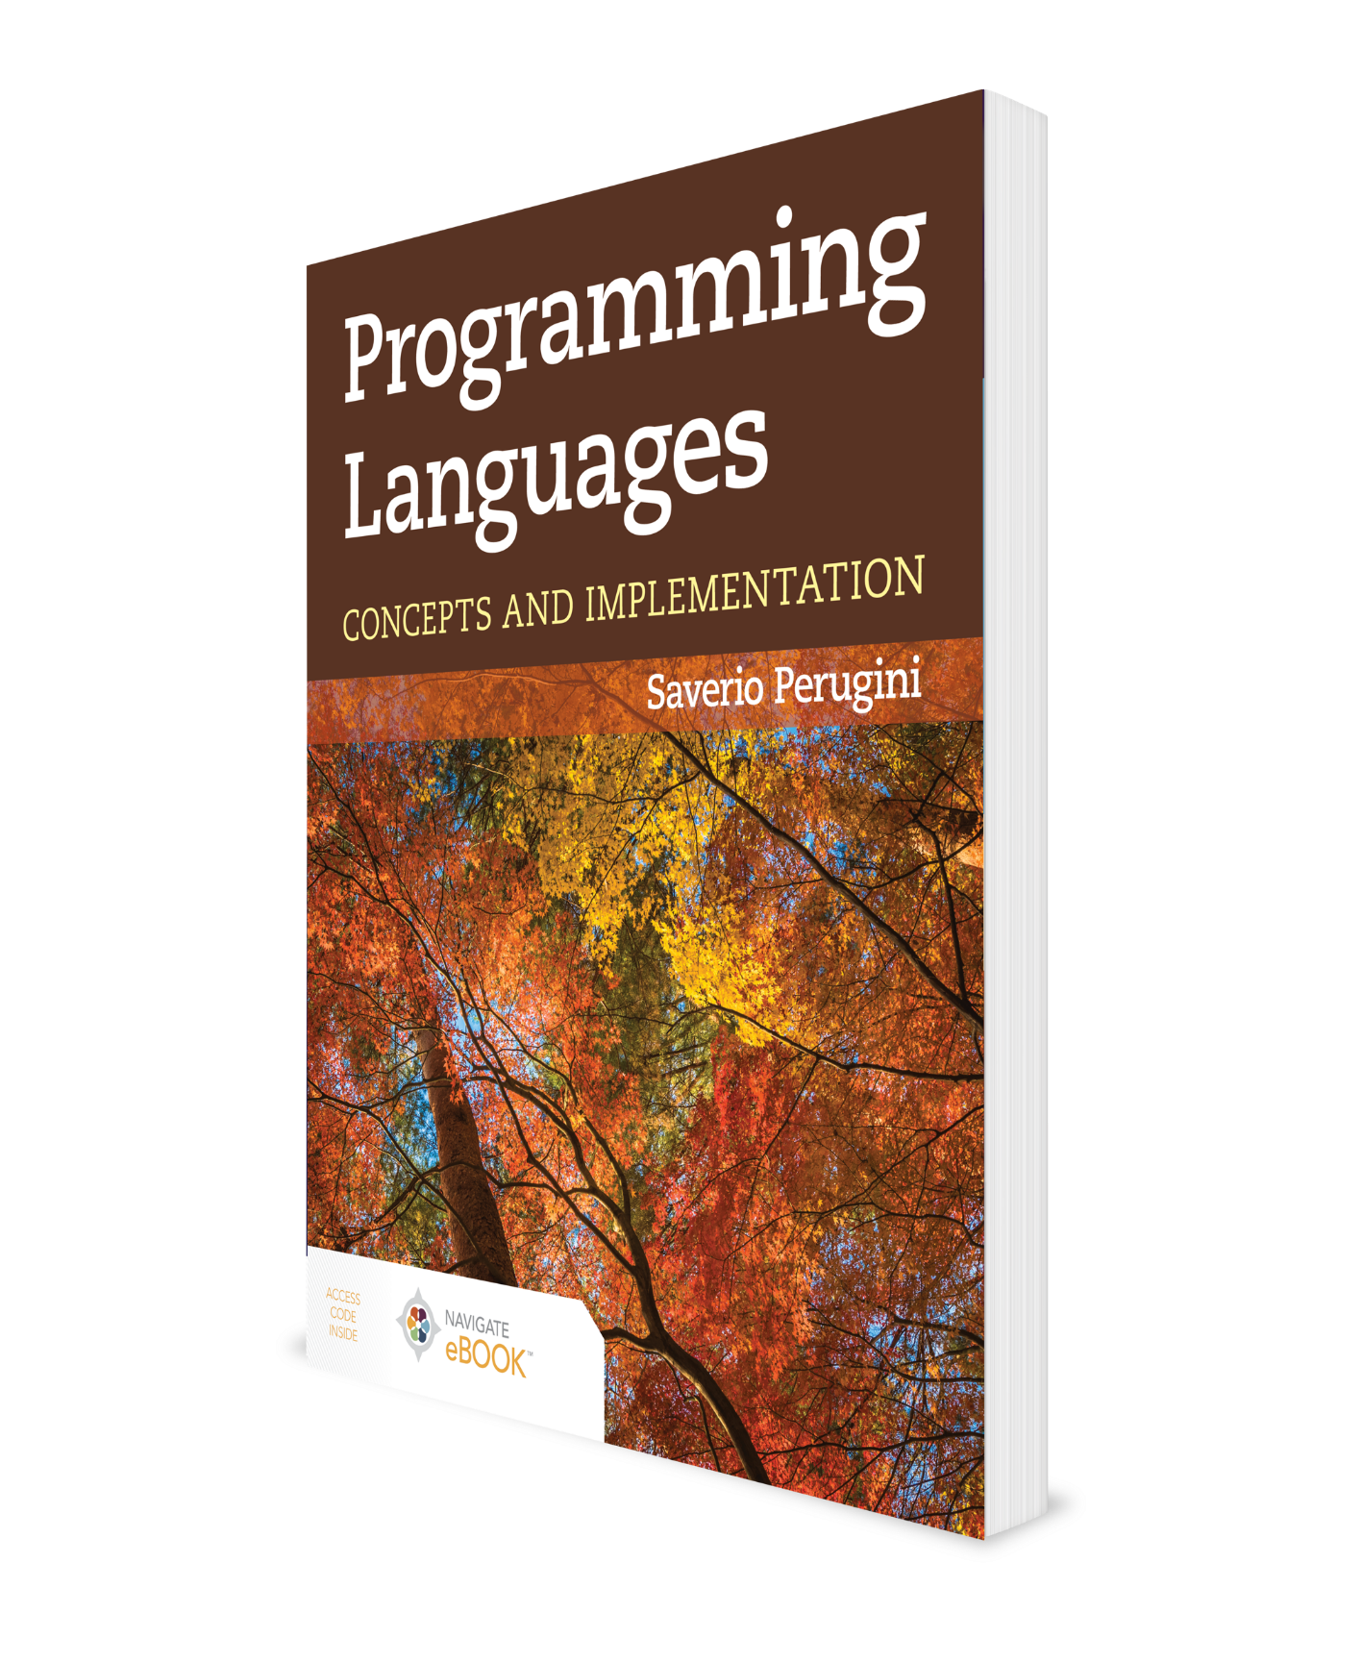
Formal Languages and Grammars
CHAPTER 2
Additional Material: Brian Hare, UMKC

Slide 2
Chapter 2: Formal Languages and Grammars
[If] one combines the words "to write-while-not-writing’’: for then it means, that he has the power to write and not to write at once; whereas if one does not combine them, it means that when he is not writing he has the power to write.
— Aristotle, Sophistical Refutations, Book I, Part 4
Never odd or even
Is it crazy how saying sentences backwards creates backwards sentences saying how crazy it is
In this chapter, we discuss the constructs (e.g., regular expressions and context-free grammars) for defining programming languages and explore their capabilities and limitations.

Slide 3
Outline
2.1 Chapter Objectives
2.2 Introduction to Formal Languages
2.3 Regular Expressions and Regular Languages
2.4 Grammars and Backus–Naur Form
2.5 Context-Free Languages and Grammars
2.6 Language Generation: Sentence Derivations
2.7 Language Recognition: Parsing
2.8 Syntactic Ambiguity
2.9 Grammar Disambiguation
2.10 Extended Backus–Naur Form
2.11 Context-Sensitivity and Semantics
2.12 Thematic Takeaways
2.13 Chapter Summary

Slide 4
2.1 Chapter Objectives
Introduce syntax and semantics.
Describe formal methods for defining the syntax of a programming language.
Establish an understanding of regular languages, expressions, and grammars.
Discuss the use of Backus–Naur Form to define grammars.
Establish an understanding of context-free languages and grammars
Introduce the role of context in programming languages and the challenges in modeling context.

Slide 5
2.2 Introduction to Formal Languages
What is a formal language?
Set of sentences (strings) over some alphabet
Legal strings = sentences
How do we define a formal language?
Grammar (define syntax of a language)
Any more
Syntax and semantics
Syntax refers to structure or form of language.
Semantics refers to meaning of language.
Previously, both syntax and semantics:
Used to be described intuitively
Now, well-defined, formal systems are available
There are finite and infinite languages.
Is C an infinite language?
Most interesting languages are infinite.

Slide 6
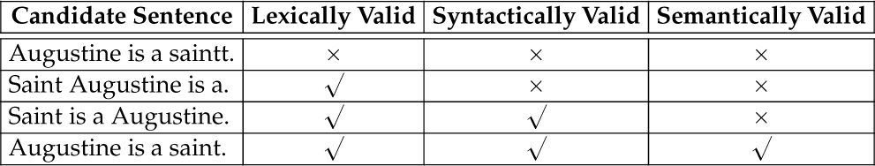
Progressive Types of Sentence Validity

Slide 7
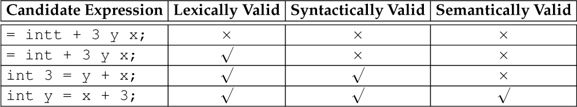
Progressive Types of Program Expression Validity

Slide 8
Outline
2.1 Chapter Objectives
2.2 Introduction to Formal Languages
2.3 Regular Expressions and Regular Languages
2.4 Grammars and Backus–Naur Form
2.5 Context-Free Languages and Grammars
2.6 Language Generation: Sentence Derivations
2.7 Language Recognition: Parsing
2.8 Syntactic Ambiguity
2.9 Grammar Disambiguation
2.10 Extended Backus–Naur Form
2.11 Context-Sensitivity and Semantics
2.12 Thematic Takeaways
2.13 Chapter Summary

Slide 9
2.3.1 Regular Expressions
Lexemes can be formally described by regular grammars.
+ (or)
* (0 or more of previous character)
Parentheses used for precedence

Slide 10
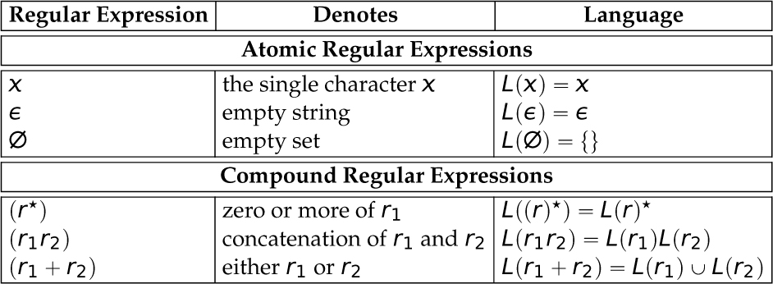
Table 2.3 Regular Expressions (Key: X ∈ Σ.)

Slide 11
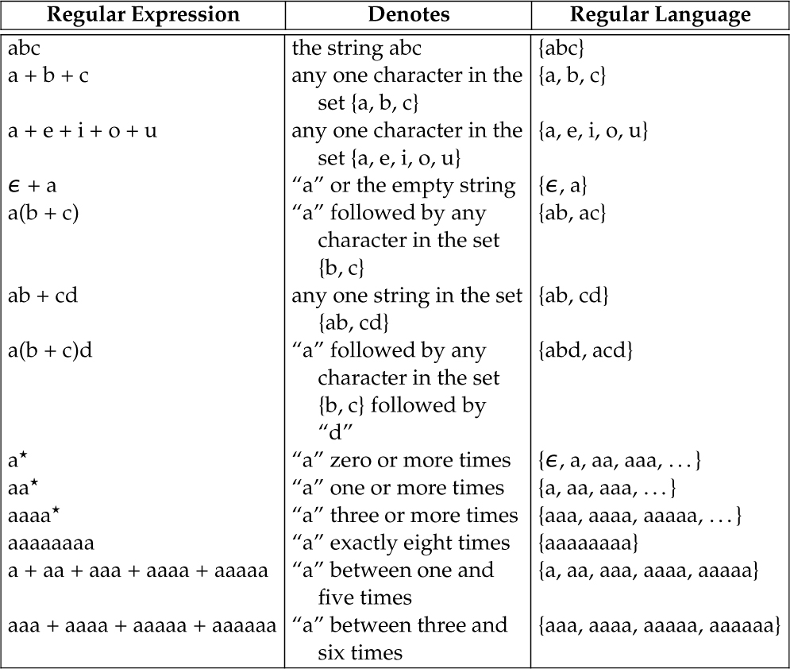
Table 2.4 Regular Expression Examples (Σ_{RE} = {ε, ∅, *, +, (, )}.)

Slide 12
2.3.2 Finite-State Automata
A regular expression intensionally denotes (the sentences of) a regular language.
A finite-state automaton (FSA) is a model of computation used to recognize whether a string is a sentence in a particular language.
We can think of an automaton as a simplified computer (Figure 2.1).
A computational mechanism that can decide whether a string is a sentence in a particular language—the set-membership problem

Slide 13
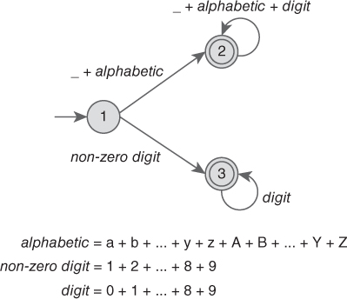
Finite State Automaton to Accept Positive Integers and Identifiers in C

Slide 14
2.3.3 Regular Languages
Regular grammars (also called linear grammars) are generative devices for regular languages.
Regular grammars define regular languages.
Any finite language is regular.
Sentences from regular languages are recognized using finite state automata (FSA).

Slide 15
Outline
2.1 Chapter Objectives
2.2 Introduction to Formal Languages
2.3 Regular Expressions and Regular Languages
2.4 Grammars and Backus–Naur Form
2.5 Context-Free Languages and Grammars
2.6 Language Generation: Sentence Derivations
2.7 Language Recognition: Parsing
2.8 Syntactic Ambiguity
2.9 Grammar Disambiguation
2.10 Extended Backus–Naur Form
2.11 Context-Sensitivity and Semantics
2.12 Thematic Takeaways
2.13 Chapter Summary

Slide 16
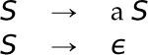
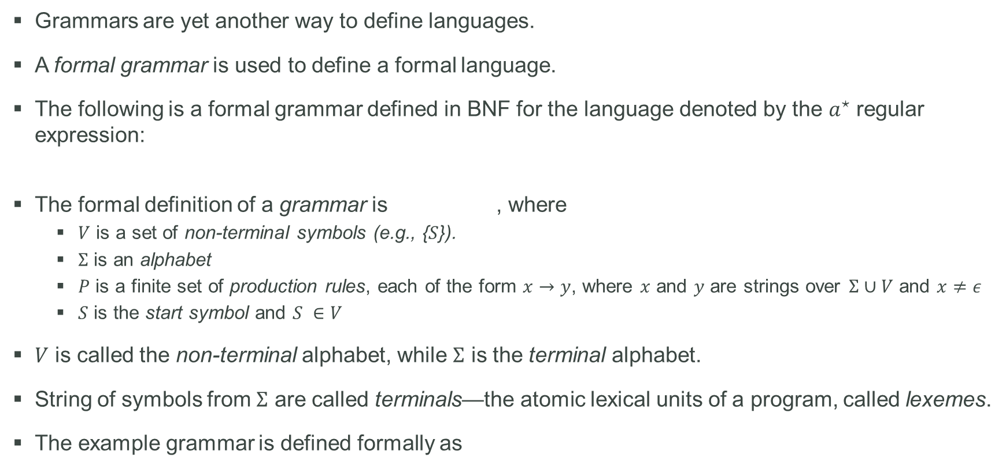
2.4 Grammars and Backus–Naur Form (1 of 2)
Grammars are yet another way to define languages.
A formal grammar is used to define a formal language.
The following is a formal grammar defined in BNF for the language denoted by the $a^{⋆}$ regular expression:
The formal definition of a grammar is , where
$V$ is a set of non-terminal symbols (e.g., {$S$}).
$Σ$ is an alphabet
$P$ is a finite set of production rules, each of the form $x→y$, where $x$ and $y$ are strings over $Σ∪V$ and $x≠ε$
$S$ is the start symbol and $S ∈V$
$V$ is called the non-terminal alphabet, while $Σ$ is the terminal alphabet.
String of symbols from $Σ$ are called terminals—the atomic lexical units of a program, called lexemes.
The example grammar is defined formally as

Slide 17
2.4 Grammars and Backus–Naur Form (2 of 2)
Stream of tokens must conform to a grammar (must be arranged in a particular order).
Grammars define how sentences are constructed.
Defined using a metalanguage notation called Backus–Naur form (BNF)
John Backus at IBM for Algol 58
Peter Naur for Algol 60
Noam Chomsky
By applying the production rules, beginning with the start symbol, a grammar can be used to generate a sentence from the language it defines.
The following is a derivation of the sentence aaaa:

Slide 18
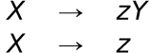
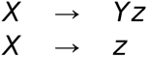
2.4.1 Regular Grammars (left- and right-linear grammars)
A grammar is a regular grammar if and only if every production rule is in one of the following two forms:
A grammar whose production rules conform to these patterns is called a right-linear grammar.
Grammars whose production rules conform to the following pattern are called left-linear grammars:
Left-linear grammars also generate regular languages.

Slide 19
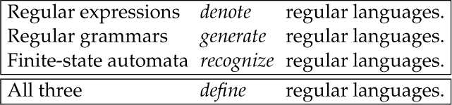
Table 2.5 Relationship of Regular Expressions, Regular Grammars, and Finite-State Automata to Regular Languages

Slide 20
Outline
2.1 Chapter Objectives
2.2 Introduction to Formal Languages
2.3 Regular Expressions and Regular Languages
2.4 Grammars and Backus–Naur Form
2.5 Context-Free Languages and Grammars
2.6 Language Generation: Sentence Derivations
2.7 Language Recognition: Parsing
2.8 Syntactic Ambiguity
2.9 Grammar Disambiguation
2.10 Extended Backus–Naur Form
2.11 Context-Sensitivity and Semantics
2.12 Thematic Takeaways
2.13 Chapter Summary

Slide 21
2.5 Context-Free Languages and Grammars
The productions of a context-free grammar may have only one non-terminal on the left-hand side.
Formally, a grammar is a context-free grammar if and only if every production rule is in the following form:
there is only one non-terminal on the left-hand side of any rule, and X can be replaced with γ anywhere.

Slide 22
Outline
2.1 Chapter Objectives
2.2 Introduction to Formal Languages
2.3 Regular Expressions and Regular Languages
2.4 Grammars and Backus–Naur Form
2.5 Context-Free Languages and Grammars
2.6 Language Generation: Sentence Derivations
2.7 Language Recognition: Parsing
2.8 Syntactic Ambiguity
2.9 Grammar Disambiguation
2.10 Extended Backus–Naur Form
2.11 Context-Sensitivity and Semantics
2.12 Thematic Takeaways
2.13 Chapter Summary

Slide 23
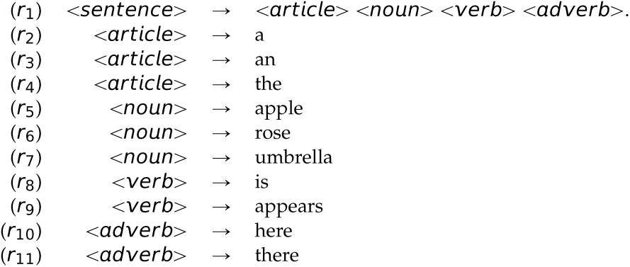
2.6 Language Generation: Sentence Derivations (1 of 3)
Consider the following a context-free grammar defined in BNF for simple English sentences:
Elements:
Grammar = set of production rules
Start symbol (<sentence>)
Non-terminals (e.g., <article>, <noun>, <verb>, <adverb>)
Terminals (e.g., a, an, the, apple, rose, umbrella, is, appears, here, there)

Slide 24
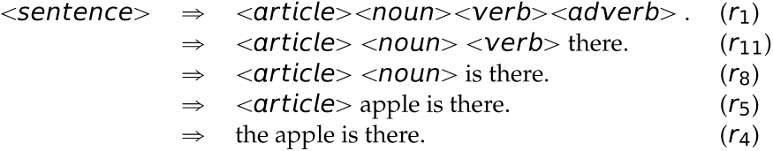
2.6 Language Generation: Sentence Derivations (2 of 3)
What can we use grammars for?
Language generation
Apply the rules in a top-down fashion
Construct a derivation
Deriving sentences from the above grammar; derive “the apple is there" (=> means ``derive’’)

Slide 25
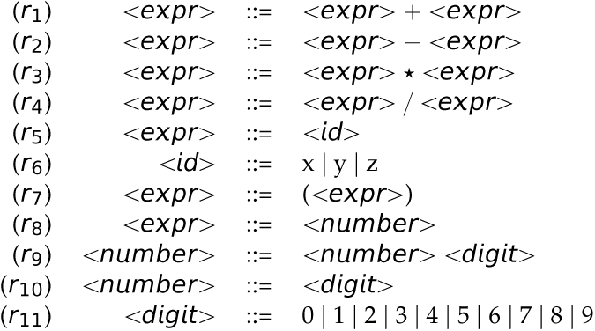
Grammar for a Four-Function Calculator
Grammar for a simple arithmetic expressions for a simple four-function calculator:

Slide 26
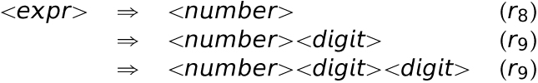
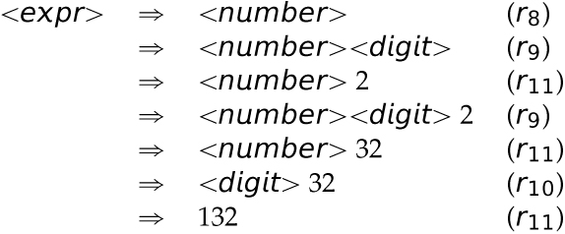
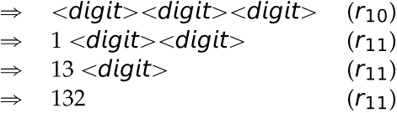
2.6 Language Generation: Sentence Derivations (3 of 3)
There are leftmost and rightmost derivations.
Some derivations are neither leftmost nor rightmost.
Sample derivations of 132:
Leftmost derivation:
Rightmost derivation:

Slide 27
Outline
2.1 Chapter Objectives
2.2 Introduction to Formal Languages
2.3 Regular Expressions and Regular Languages
2.4 Grammars and Backus–Naur Form
2.5 Context-Free Languages and Grammars
2.6 Language Generation: Sentence Derivations
2.7 Language Recognition: Parsing
2.8 Syntactic Ambiguity
2.9 Grammar Disambiguation
2.10 Extended Backus–Naur Form
2.11 Context-Sensitivity and Semantics
2.12 Thematic Takeaways
2.13 Chapter Summary

Slide 28
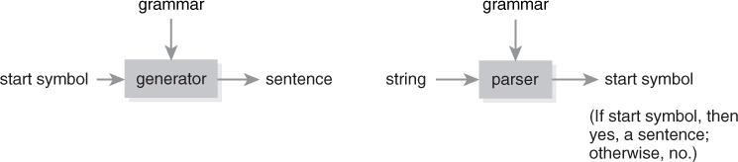
2.7 Language Recognition: Parsing
Is a grammar a generative device or recognition device?
Language recognition; do the reverse
Generation: grammar → sentence
Recognition: sentence → grammar
Figure 2.2 The dual nature of grammars as generative and recognition devices.

Slide 29
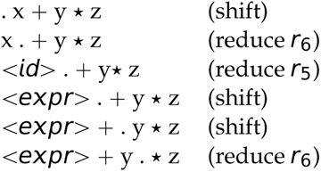
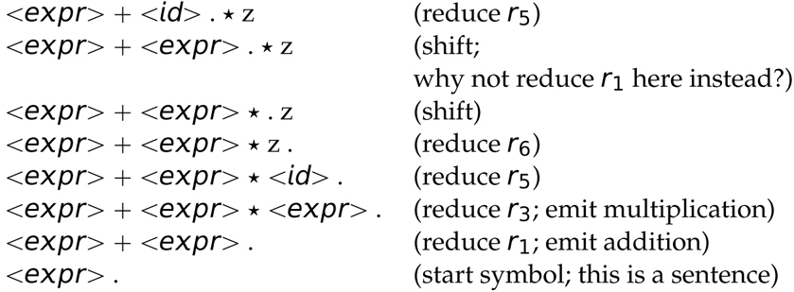
2.7 Language Generation and Recognition
Let’s parse x + y * z (do the reverse):
. (dot) denotes the top of the stack.
The right-hand side is called the handle.
This process is called bottom-up or shift-reduce parsing.

Slide 30
Outline
2.1 Chapter Objectives
2.2 Introduction to Formal Languages
2.3 Regular Expressions and Regular Languages
2.4 Grammars and Backus–Naur Form
2.5 Context-Free Languages and Grammars
2.6 Language Generation: Sentence Derivations
2.7 Language Recognition: Parsing
2.8 Syntactic Ambiguity
2.9 Grammar Disambiguation
2.10 Extended Backus–Naur Form
2.11 Context-Sensitivity and Semantics
2.12 Thematic Takeaways
2.13 Chapter Summary

Slide 31
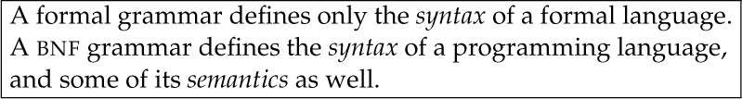
Table 2.6 Formal Grammars Vis-à-Vis BNF Grammars

Slide 32
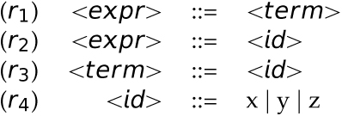
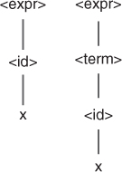
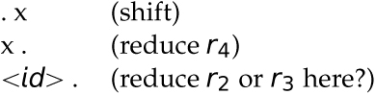
Shift-Reduce and Reduce-Reduce Conflicts
We would like part of the meaning (or semantics) to be determined from the grammar (or syntax).
The previous parse exhibits a shift-reduce conflict.
If we shift, multiplication will have higher precedence (desired).
If we reduce, addition will have higher precedence (undesired).
There is also a reduce-reduce conflict (the above parse does not have one); consider the following:
Let's parse x
Parse Trees for the Expression x:

Slide 33
2.8.2 Parse Trees
The underlying source of shift-reduce and reduce-reduce conflicts is an ambiguous grammar.
A grammar is ambiguous if there exists a sentence that can be parsed in more than one way.
A parse of a sentence can be graphically represented using a parse tree.
A parse tree is a tree whose root is the start symbol of the grammar, non-leaf vertices are non-terminals, and leaves are terminals.
A parse tree is fully expanded.

Slide 34
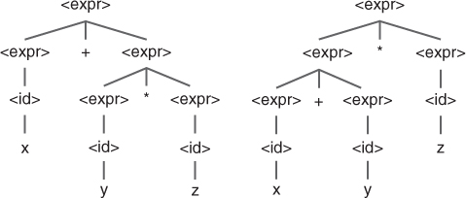
Figure 2.3 Parse Trees for x + y * z

Slide 35
Figure 2.4 Parse Trees for x

Slide 36
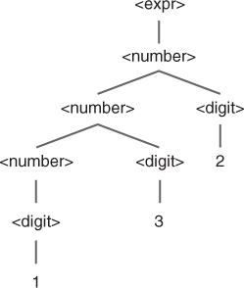
Figure 2.5 Parse Tree for the Expression 132

Slide 37
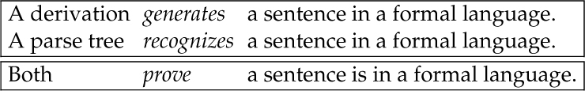
Table 2.7 The Dual Use of Grammars: For Generation (Constructing a Derivation) and Recognition (Constructing a Parse Tree)

Slide 38
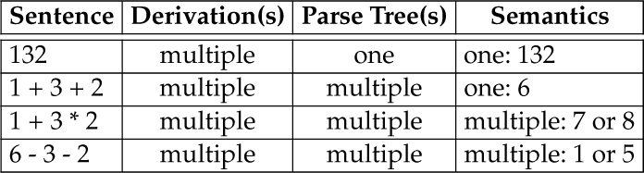
Table 2.8 Effect of Ambiguity on Semantics
If a sentence from a language has more than one parse tree, then the grammar for the language is ambiguous.
Last three rows of Table 2.8 (shown here) make the grammar ambiguous.

Slide 39
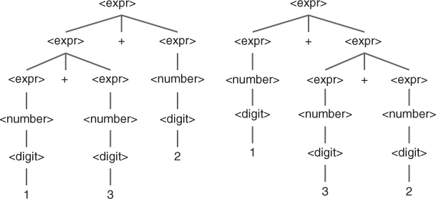
Figure 2.6 Parse Trees for the Expression 1 + 3 + 2

Slide 40
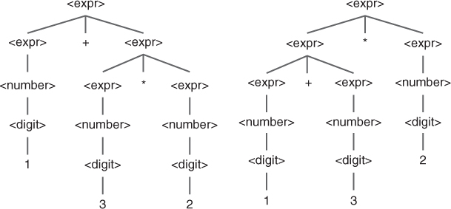
Figure 2.7 Parse Trees for the Expression 1 + 3 * 2
<Insert Figure 2.7>

Slide 41
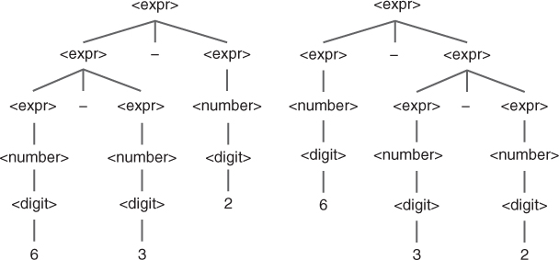
Figure 2.8 Parse Trees for the Expression 6 - 3 - 2

Slide 42
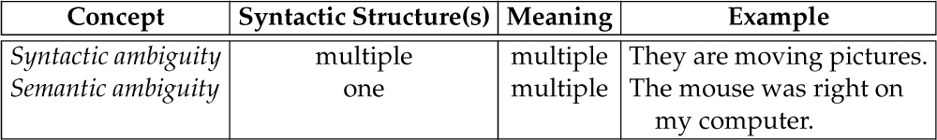
Table 2.9 Syntactic Ambiguity Vis-à-Vis Semantic Ambiguity

Slide 43
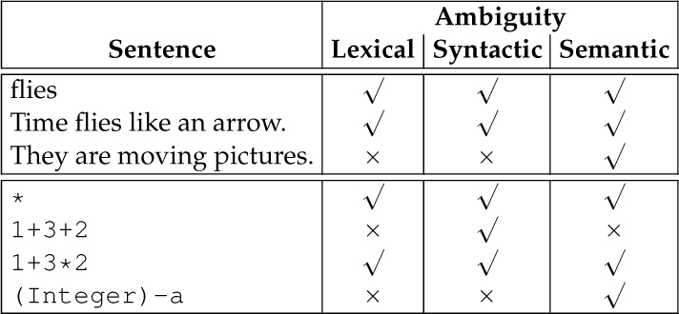
Table 2.11 Interplay Between and Interdependence of Types of Ambiguity

Slide 44
How to Prove a Grammar Is Ambiguous
Generate an expression from the grammar and show the expression.
Give two parse trees "using the grammar" for that expression.
Notes:
The expression must come from the grammar.
A parse tree is fully expanded; it has no leaves that are non-terminals; they are all terminals.
Collected leaves in each parse tree must constitute the expression.
You cannot change the grammar while building the parse trees.
You cannot change the expression while building the parse trees.

Slide 45
2.9 Grammar Disambiguation
Desideratum: syntax imply semantics
Precedence
Associativity
What does “have higher precedence’’ mean?
Occurs lower in the parse tree because expressions are evaluated bottom-up.
Solution: either
State a disambiguating rule (order of precedence)
e.g., * has higher precedence than + (most languages, except APL)
Often implemented as “if more than 1 rule applies, prefer the one listed first in the grammar.” This breaks several rules of mathematics applied to grammars, but works.
Revise grammar to disambiguate it
Not always possible
Some grammars are inherently ambiguous.
For example, the “nearest preceding if” rule for if-else clauses

Slide 46
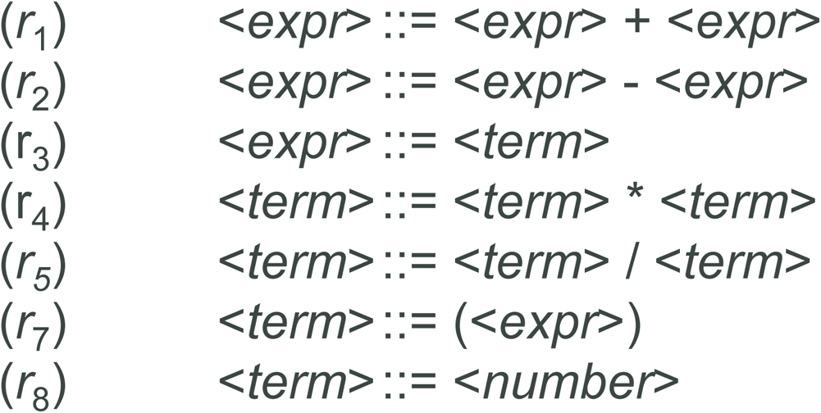
2.9.1 Operator Precedence
Worked out solution for x + y * z
Is this still ambiguous? Yes. Why?
How can we disambiguate it?
Grammar revision:
Introduce new steps (non-terminals) in the non-terminal cascade so that multiplications are always lower than additions in the parse tree.

Slide 47
2.9.2 Associativity of Operators (1 of 2)
Associativity
Comes into play when dealing with operators with same precedence
6-3-2 = (6-3)-2 = 1 (left associative)
- - - 6 = -(-(-6))) = -6 (right associative)
Matters when adding floating-point numbers, or
With an operator such as subtraction (e.g., 6-3-2)
Which operators in C are right-associative?
Overcoming ambiguity of associativity
Left-recursive rules lead to left associativity.
Right-recursive rules leads to right associativity.

Slide 48
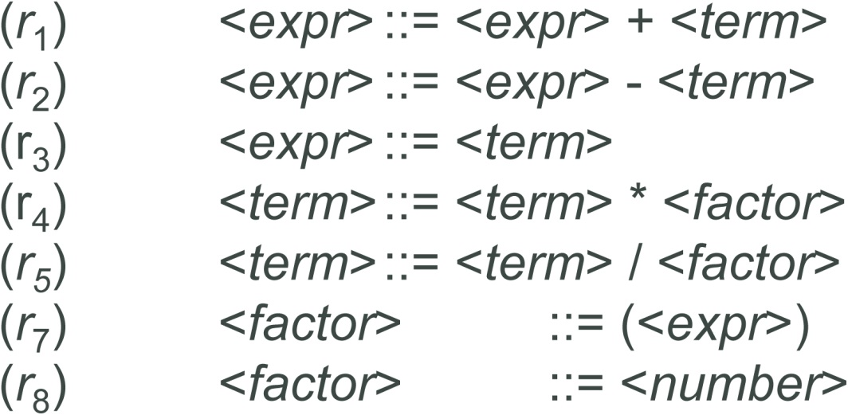
2.9.2 Associativity of Operators (2 of 2)
Grammar still ambiguous for 1 + 3 + 2 and 6 - 3 - 2?
Let's fix it and make it left-associative
Theme: add another level of indirection by introducing a new non-terminal
Notice rules get lengthy
Why do we prefer a small rule set?

Slide 49
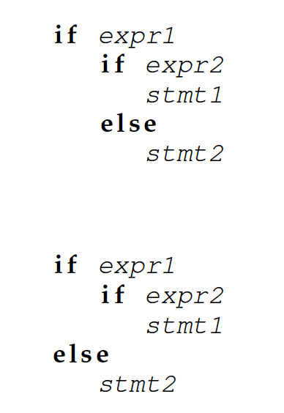
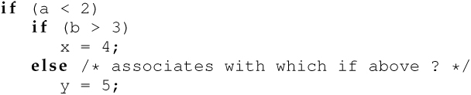
2.9.3 The Classical Dangling else Problem (1 of 2)
To which if does the else associate?
Source of problem: an ambiguous grammar

Slide 50
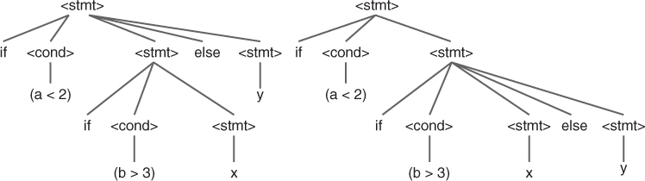
2.9.3 The Classical Dangling else Problem (2 of 2)
Parse trees for the sentence if (a < 2) if (b > 3) x else y.
(left) Parse tree for an if–if–else construction. (right) Parse tree for an if–if–else construction.

Slide 51
Outline
2.1 Chapter Objectives
2.2 Introduction to Formal Languages
2.3 Regular Expressions and Regular Languages
2.4 Grammars and Backus–Naur Form
2.5 Context-Free Languages and Grammars
2.6 Language Generation: Sentence Derivations
2.7 Language Recognition: Parsing
2.8 Syntactic Ambiguity
2.9 Grammar Disambiguation
2.10 Extended Backus–Naur Form
2.11 Context-Sensitivity and Semantics
2.12 Thematic Takeaways
2.13 Chapter Summary

Slide 52
2.10 Extended Backus–Naur Form (EBNF)
EBNF adds includes the following syntactic extensions to BNF.
| means ``alternation.’’
[x] means ``x is is optional’.’
{x}* means ``zero or more of x.’’
{x}+ means ``one or more of x’’
{x}*(c) means ``zero or more of xs separated by cs.’’
{x}+(c) means ``one or more of xs separated by cs.’’
EBNF is often more convenient, but gains us no new expressive power; anything in EBNF can be written in ‘ordinary’ BNF

Slide 53
Outline
2.1 Chapter Objectives
2.2 Introduction to Formal Languages
2.3 Regular Expressions and Regular Languages
2.4 Grammars and Backus–Naur Form
2.5 Context-Free Languages and Grammars
2.6 Language Generation: Sentence Derivations
2.7 Language Recognition: Parsing
2.8 Syntactic Ambiguity
2.9 Grammar Disambiguation
2.10 Extended Backus–Naur Form
2.11 Context-Sensitivity and Semantics
2.12 Thematic Takeaways
2.13 Chapter Summary

Slide 54
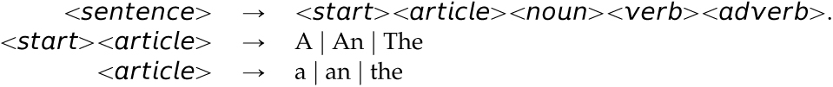
2.11 Context-Sensitivity and Semantics
What is an example of something that is context-sensitive? Or something that is not context-free?
First letter of a sentence must be capitalized.
Augustine is a saint.
The saint is Augustine.
An example context-sensitive grammar (CSG) for this:
Other examples of context:
A variable must be declared before it is used.
* operator in C

Slide 55
Semantics
Static semantics
Declaring a variable before its usage
Type compatibility
Can use attribute grammars
Dynamic semantics (in order from least to most formal)
Operational (interpreter implementation; Chapters 10–12)
Denotational
Axiomatic

Slide 56
Outline
2.1 Chapter Objectives
2.2 Introduction to Formal Languages
2.3 Regular Expressions and Regular Languages
2.4 Grammars and Backus–Naur Form
2.5 Context-Free Languages and Grammars
2.6 Language Generation: Sentence Derivations
2.7 Language Recognition: Parsing
2.8 Syntactic Ambiguity
2.9 Grammar Disambiguation
2.10 Extended Backus–Naur Form
2.11 Context-Sensitivity and Semantics
2.12 Thematic Takeaways
2.13 Chapter Summary

Slide 57
2.12 Thematic Takeaways
The identifiers and numbers in programming languages can be described by a regular grammar.
The (nested) expressions in programming languages can be described by a context-free grammar.
Neither a regular nor a context-free grammar can describe the rule that a variable must be declared before it is used.
Grammars are language recognition devices as well as language generative devices.
An ambiguous grammar poses a problem for language recognition.
Two parse trees for the same sentence from a language are sufficient to prove that the grammar for the language is ambiguous.
Semantic properties, including precedence and associativity, can be modeled in a context-free grammar.

Slide 58
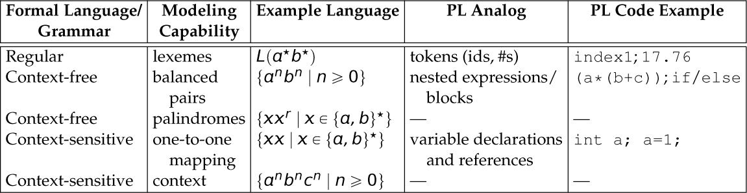
2.13 Chapter Summary
Table 2.12 Formal Grammar Capabilities Vis à Vis Programming Language Constructs (Key: PL = programming language.)

Slide 59
Constructs and Capabilities
Regular grammars can capture rules for a valid identifier and integer in C or Java.
Context-free grammars can capture rules for a valid mathematical expression in C or Java.
Neither can capture fact that a variable must be declared before it is used.
Can model/push semantic properties like precedence and associativity into a context-free grammar

Slide 60
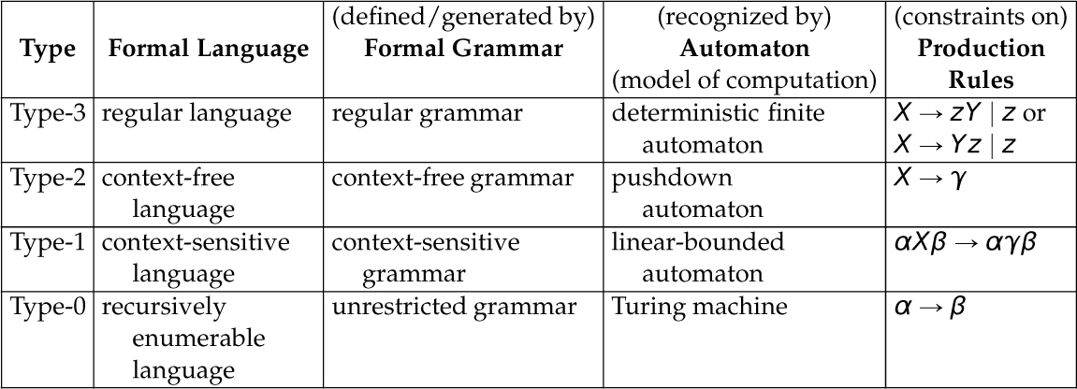
The Chomsky Hierarchy
Table 2.13 Summary of Formal Languages and Grammars, and Models of Computation

